Slide 1
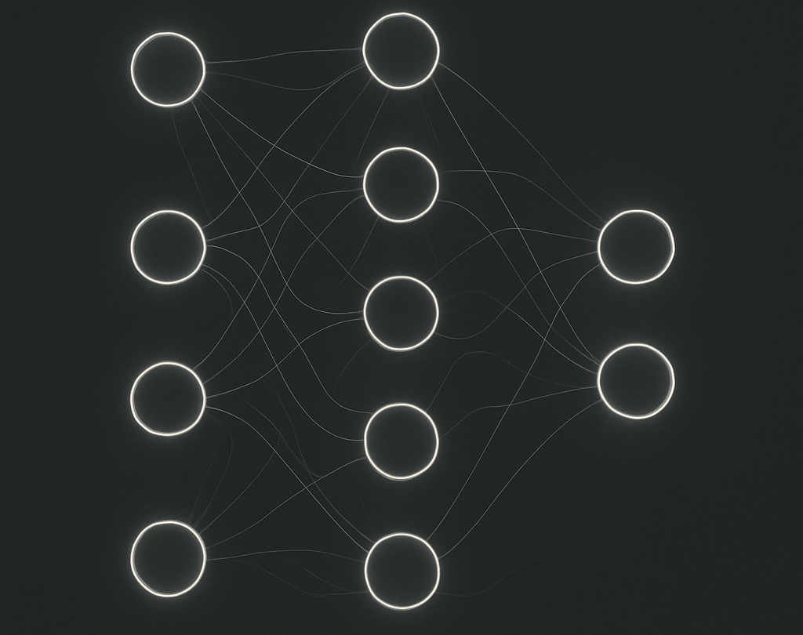
Deep Learning Methods for Text Classification
~ Lucas Milazzo ~
Data Science Senior Capstone

Slide 2
Abstract
Natural Language Processing is becoming more and more relevant in today's world. Tools like ChatGPT, DeepSeek, Claude and Grok use machine learning models such as transformers to interact with and understand human language. The development and extremely widespread use of these models further prove that NLP is a technology that should be further explored and improved. There are many NLP tasks such as POS tagging, synonym checking, text generation, speech recognition, and text classification. This project seeks to explore the methods and architecture of neural networks used for text classification with a concentration on sentiment/emotion classification.

Slide 3
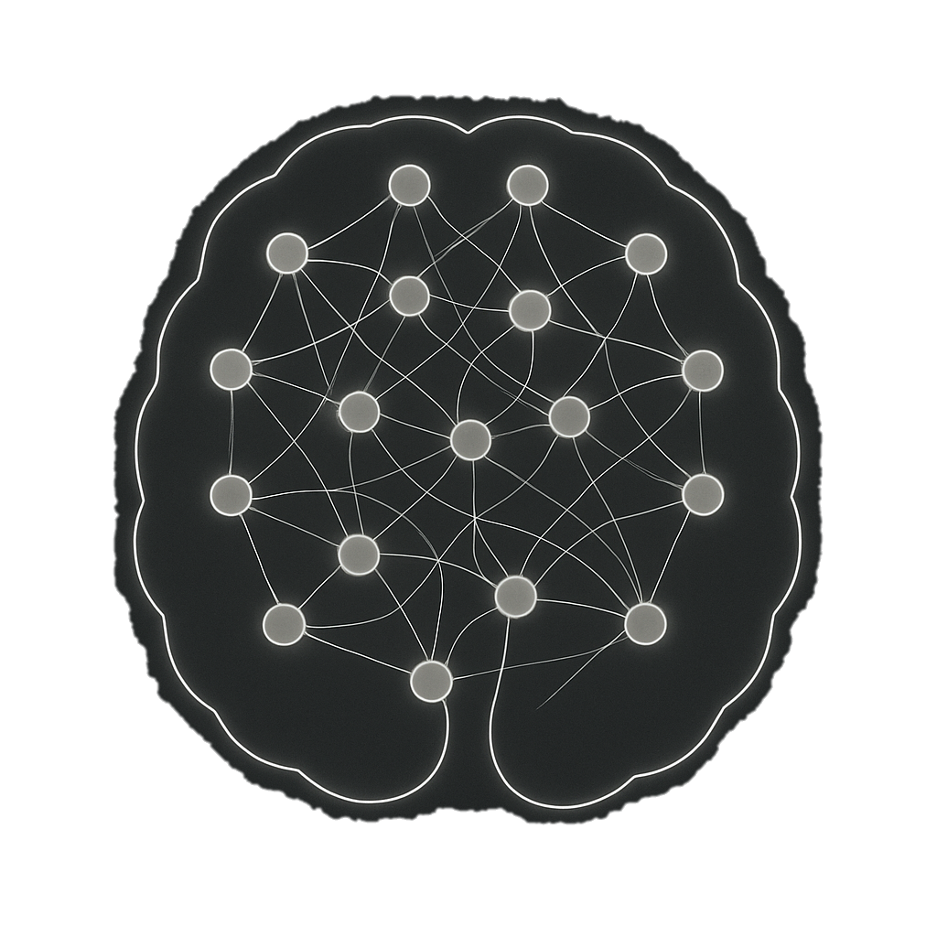
Section 1: Words & Numbers
Natural Language ~ Machine Representation
How can we create numerical representations of language data?
Smart Representation
The method used today for many natural language models is called feature embedding. Process involves representing words as a vector of features that embed contextual meaning.

Slide 4
Section 1: Words & Numbers
Feature Embedding
Trained Weights from a prediction Model or from word usage frequency
Happy
3.04 , 5.67 , 7.20
Angry
-3.04 , -5.67 , -7.20

Slide 5
Section 1: Words & Numbers
Prediction Embedding ~ Word2Vec
CBOW
Skip-Gram
Am
You
Not
Feel
Was
I
s
Go
I , ? , excited
? , will , ?
3.04 , 5.67 , 7.20
3.18 , -5.67 , 2.20
3.04 , 5.67 , 7.20

Slide 6
Section 1: Words & Numbers
Contextual Embedding ~ Transformer Methods
Set
[4.3, 2.5, 9.0]
[-5.2, 0.56, -70]
[2.9, -0.11, -5.6]
Predetermined
Volleyball Action
To Place Down
Self-Attention Layer
Creates relationships between words in a sequence without the restrictions of a window size used in Word2Vec, RNNs, or CNNs.
Possession
Words are given weighted scores for the other words based on learned dependence and relationship throughout text corpus.
The, dog, wagged, its, tail
Action
Action
Additional Methods
GloVe, BERT, FastTest, ngram2Vec

Slide 7
Section 1: Words & Numbers
My Word Embeddings
For this project I trained word embeddings using the CBOW approach. Predicting the middle word in a sequence from its two context words.
This allowed for the embeddings to represent the context in which words can be used however does not necessarily represent the content of the word. For instance, words depicting emotion may commonly be used in the same context such as “I feel ____ today”, however they do not all have the same meaning.
Another drawback to this approach is that you can only ever embed one representation of each word.
My 75-feature embedding dictionary was trained using Googles Go Emotions Dataset.
Token | e1 | e2 | … | e75
Orange | 5.03 | 7.89 | … | 2.10
Casserole | 4.20 | 1.69 | … | 1.10
Canvas | 5.23 | 3.84 | … | -1.10

Slide 8
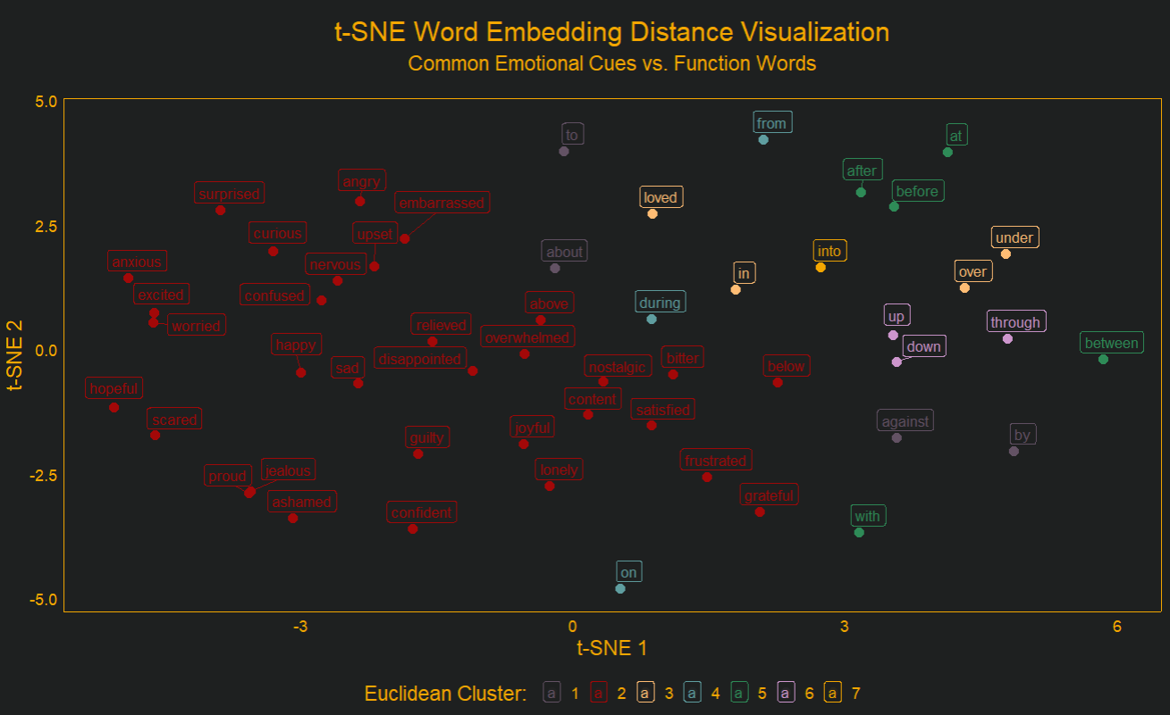
Section 1: Words & Numbers
Embedding Results: t-SNE Feature Reduction
t-distributed Stochastic Neighbor Embedding
An unsupervised non-linear dimensionality reduction algorithm

Slide 9
Section 2: Text Classification
Training Data & Classes
Classes
Sadness
Happiness
Neutral
Anger
Anxiety
The training data for the classification model was found on Kaggle. It contains around 15, 300 observations of social media posts captions and comments. These were pre-classified into 5 classes by humans and contained confidence scores for each classification.
80% Training
20% Testing

Slide 10
Section 2: Text Classification
Pre-Input Considerations
Padding
Truncating
Inputs that contained less than 30 tokens (words) were handled by adding a special token to the end, any number of times until the input length was 30 tokens.
“<PAD>”
Had its own embedding representation.
Inputs that contained more than 30 tokens (words) were handled by removing tokens from the end of the sequence until the input length was 30 tokens.
Input Length
Padding
30 Tokens
Input Length
X
30 Tokens

Slide 11
Section 3: NN Architecture
Neural Network Architecture: LSTM Layer
The Dog Walked
[2, 3, 1]
[2, 1, 5, -2, -2]
[1, 2, 3, -1, -3]
[-2, 3, 5]
[2, 2, -5, 1, -1]
Input
Embedding Sequence
LSTM Hidden-State Output
[-2, 1, -1]
Bi-Directional Long-Short Term Memory
The sequence is processed in both directions to produce new context aware embeddings.

Slide 12
Section 3: NN Architecture
Neural Network Architecture: Attention Layer
The attention layer is rather important because it is where were convert the input from a two-dimensional tensor into a single vector that represents the sentence This layer also is responsible for masking out the padding tokens that were added so that the feed-forward method pays less attention to their presence.
e1 e2 … e200
The
Man
Went
To
Work
<PAD>
3.03, 5.02, …… , 5.55
2.1
9.1
1.0
0.1
0.3
1.2
3.12
1.13
1.32
4.51
5.23
-1e9
2.03, -1.12, …… , 1.08
2.47, -4.89, …….. , 5.23
1.15, 3.71, ……… , 4.66 6.02, 7.34, ……… , 8.91 0.98, 2.56, ……… , 3.77
Padding tokens are masked with a very small number. After soft max they end up close to 0.
LSTM Output
Dot Product with a weight vector

Slide 13
Section 3: NN Architecture
Neural Network Architecture: Feed Forward
16, 1, 128
16, 1, 256
16, 1, 512
16, 1, 128
Linear
Dropout
Relu
Linear
Dropout
Relu
Linear
Dropout
Relu
Linear
Soft Max
Classification
16, 1, 5
Batch Size, Sequence Length, Feature Dimensions

Slide 14
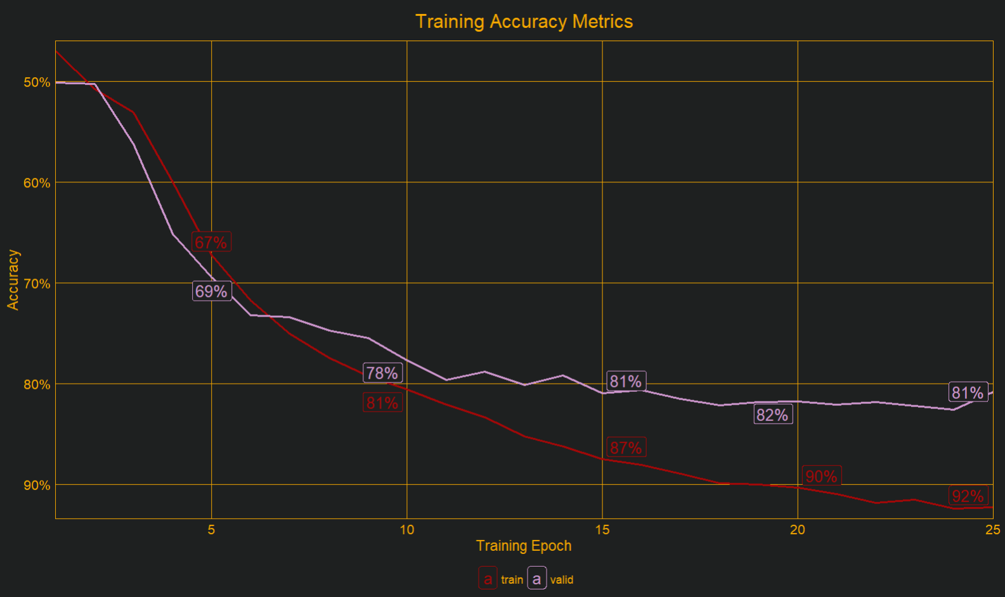
Section 4: Model Evaluation
Model Evaluation: Training Metrics
Over the course of training, I saw good improvement in both training and validation accuracy and loss. Around epoch 15 the model started to show some signs of overfitting, and it was cut of at epoch 25 to prevent further over fitting.
Throughout this project I trained dozens of models with different parameters and layer architecture I eventually decided the LSTM + Attention with this model's parameters worked the best for me.

Slide 15
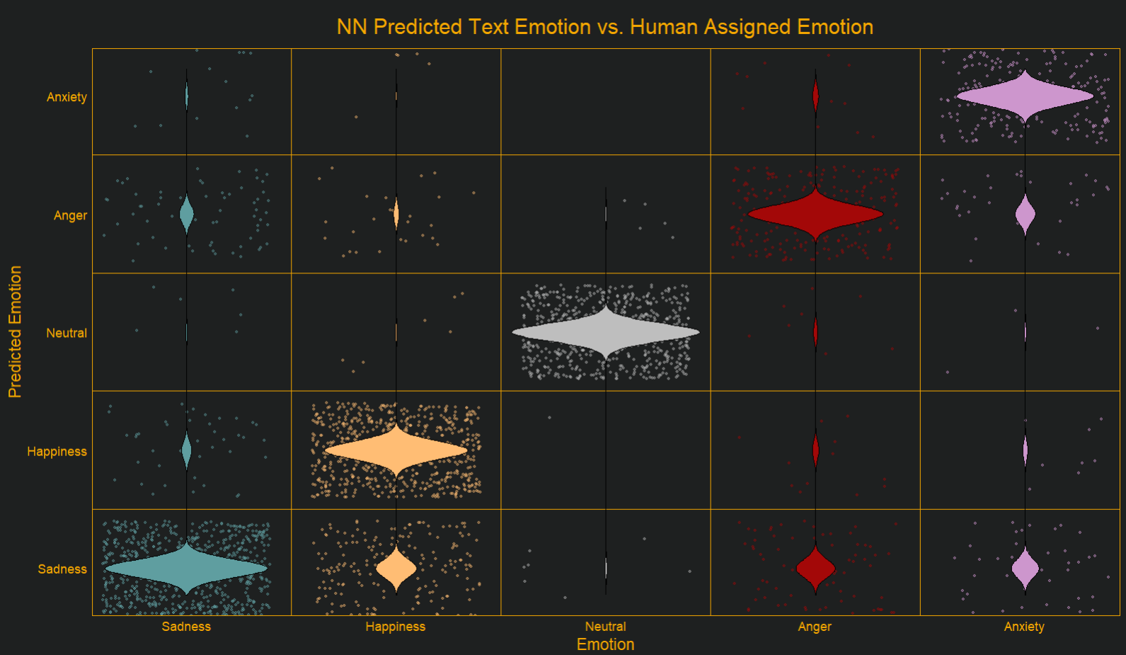
Section 4: Model Evaluation
Model Evaluation: Unseen Data
Predictions on the unseen data resulted in accuracy around ~85%. This is strikes a healthy balance between the training and validation accuracy.
Neutral was the most accurate
The Negative emotions often got mistaken for one another
Happiness Most commonly mistaken for sadness

Slide 16
Section 4: Model Evaluation
Model Evaluation: Problem Areas
A common Problem I encounter when manual testing was the difficulty the models faced when encountering “negation” terms.
Negation and ambiguous emotions were two of the most problematic areas.
Well then what are you?
I , Am, Not, Happy, Today
Modifies the meaning of happy, “negating” its original emotion meaning.
The presence of an emotion heavy word often caused the model to predict the related emotion
The addition of the LSTM layer worked well to reduce the error of this specific example. However, as edge cases like this were mostly manually input for testing, I don’t have a lot of data to model the real accuracy on these cases.
Interactions Like this caused problems as the model would see an emotion word and not be able to understand relationships between that word and modifying words around it

Slide 17
Section 4: Model Evaluation
Model Evaluation: Problem Areas
A common Problem I encounter when manual testing was the difficulty the models faced when encountering “negation” terms.
Negation and ambiguous emotions were two of the most problematic areas.
Well then what are you?
I , Am, Not, Happy, Today
Modifies the meaning of happy, “negating” its original emotion meaning.
The presence of an emotion heavy word often caused the model to predict the related emotion
The addition of the LSTM layer worked well to reduce the error of this specific example. However, as edge cases like this were mostly manually input for testing, I don’t have a lot of data to model the real accuracy on these cases.
Interactions Like this caused problems as the model would see an emotion word and not be able to understand relationships between that word and modifying words around it

Slide 18

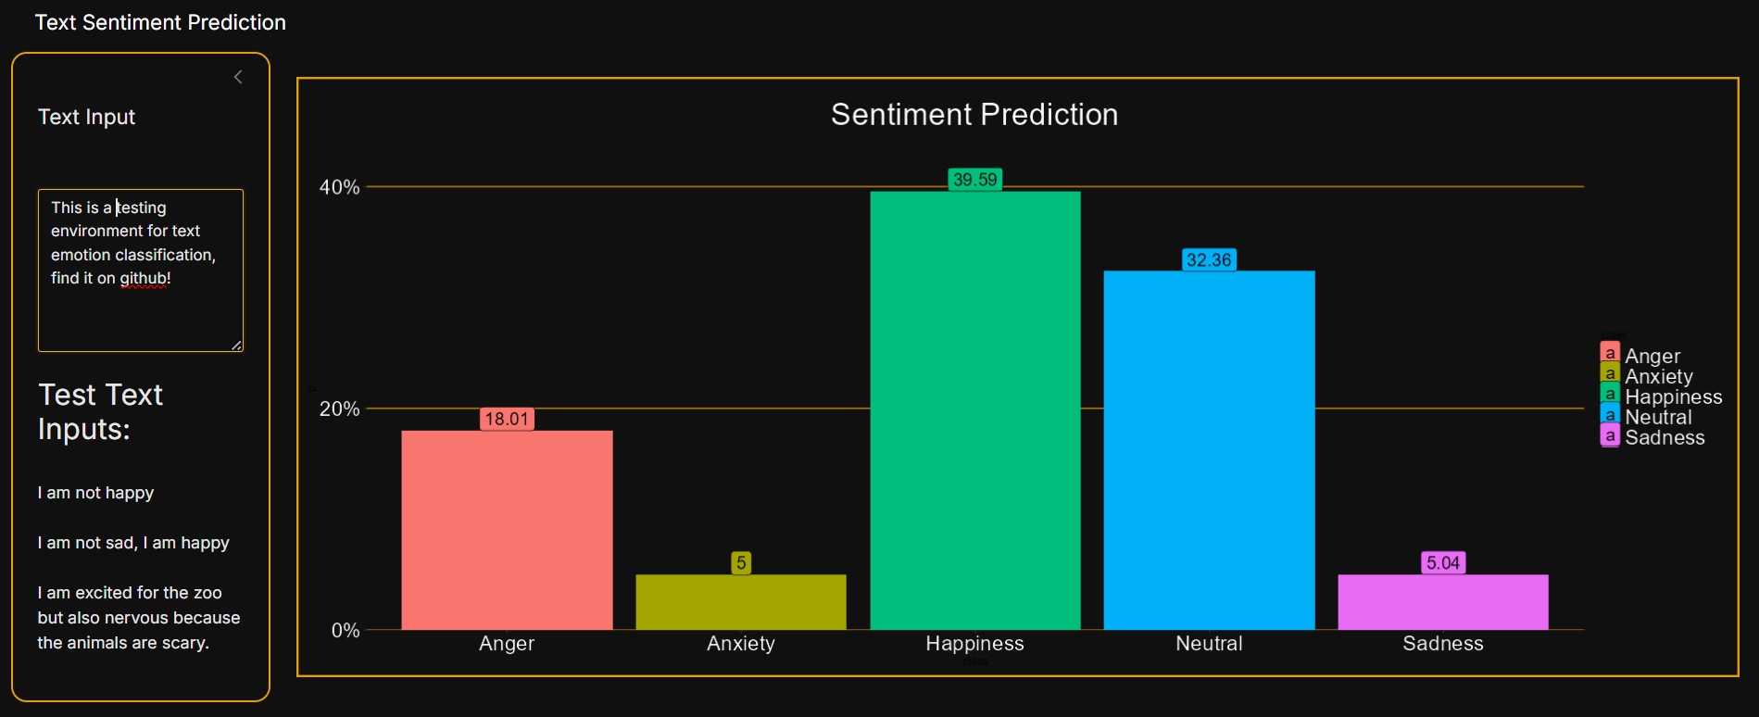
Section 4: Model Evaluation
Model Evaluation: Realistic Testing
https://github.com/LMilazzo/NNEmotionClassificationWidget/tree/main

Slide 19
Section 5: References
Müller, M., Salathé, M., & Kummervold, P. E. (2023). Covid-twitter-bert: A natural language processing model to analyse covid-19 content on twitter. Frontiers in artificial intelligence, 6, 1023281.
Wang, B., Wang, A., Chen, F., Wang, Y., & Kuo, C. C. J. (2019). Evaluating word embedding models: Methods and experimental results. APSIPA transactions on signal and information processing, 8, e19.
Tunstall, Lewis, et al. Natural Language Processing with Transformers: Building Language Applications with Hugging Face. O’Reilly Media, 2023.
Guelmani, L. (2024). Sentiment analysis [Dataset]. Kaggle. https://www.kaggle.com/datasets/guelmaniloubna/sentiments-analysis
Chanda, D. (2021). GoEmotions [Dataset]. Kaggle. https://www.kaggle.com/datasets/debarshichanda/goemotions/discussion?sort=hotness

